Slide 1
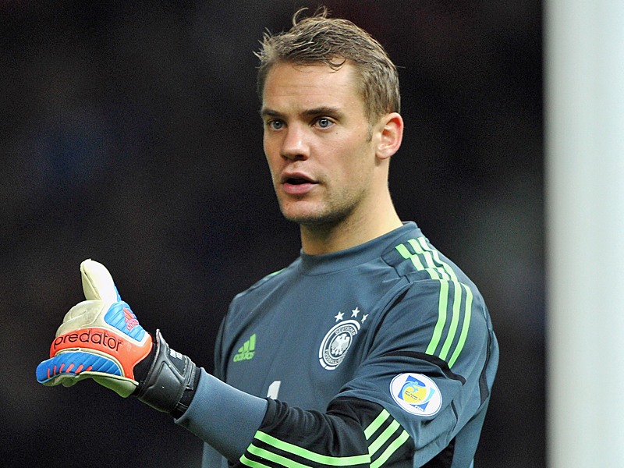
NEURO NEUER
Sebastian Schelle
Jonas Stabenow
Alessia Cecchini
Khaled Jbir
Roua Sboui

Slide 2
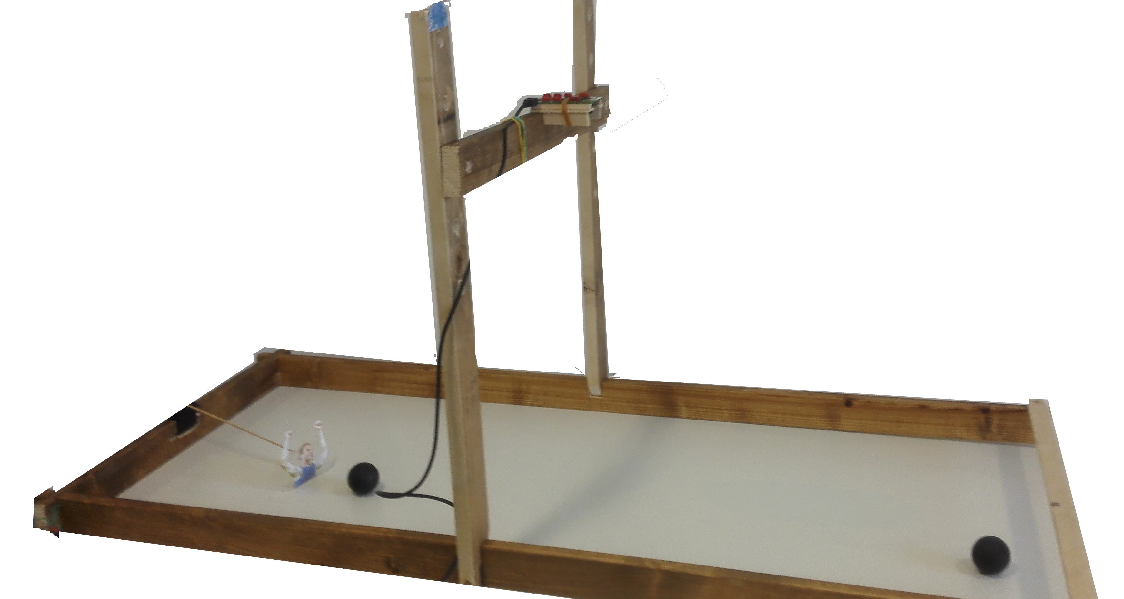
Set-up
Wooden frame
DVS
Servo
Arduino Microcontroller
Matlab

Slide 3
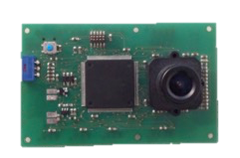
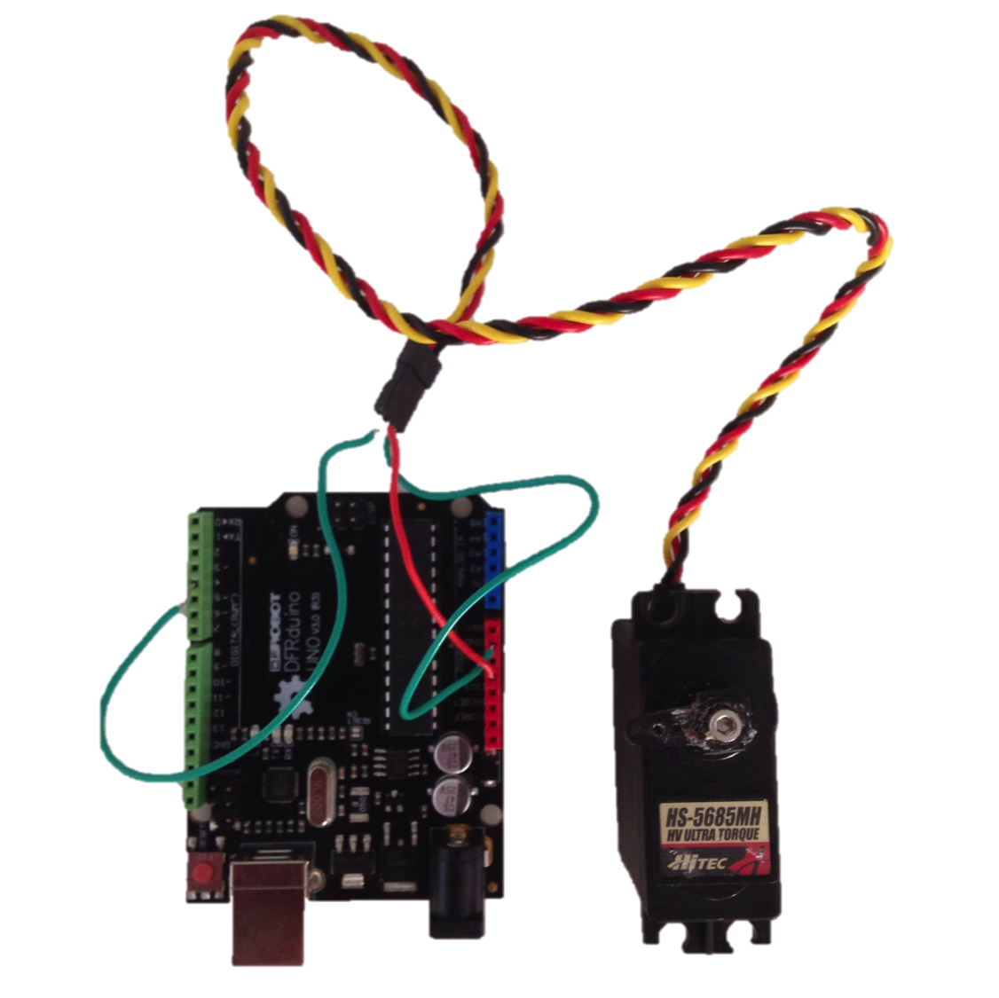
DVS camera and Servo
We used the DVS to track the ball position and velocity.
The events of the DVS were clustered using DBSCAN.
With an Arduino board we controlled the servo using matlab. The Servo controlled and moved Neuer.

Slide 4
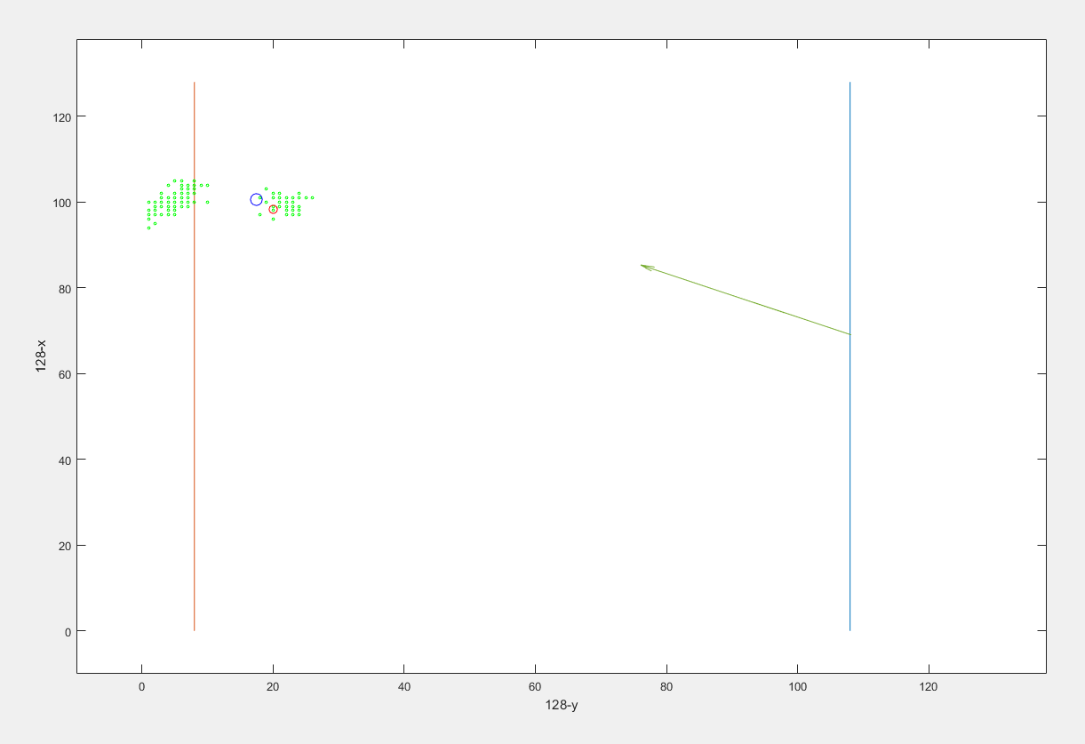
The prediction and training
When the ball crosses the blue line the Position and velocity (X,Y,dX,dY) is captured and passed to the Neural predictor.
The red circle is the prediction. This Xpred value is passed to the servo.
When the ball crosses the red line, the real ball position Xreal is determined (blue circle).
The Network is trained with the inpput(X,Y,dX,dY) and output(Xreal).
3
2
1

Slide 5
Neural Network
Advantages | Disadvantages
Performance of tasks that a linear program cannot | Learning needed to operate
Parallel nature | High processing time for large neural networks
It learns and does not need to be reprogrammed
Implemented in any application

Slide 6
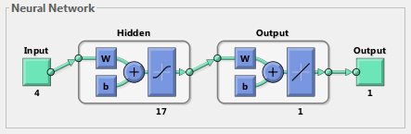
Neural Network
Input
Ball position and velocity:
X, Y, dX, dY
Inputs: 4
Hidden layers: 7 to 30
Output: 1
Output
Desired Neuroneuer position:
X

Slide 7
Thanks for your attention
-> live demo

